Slide 1

Fundamentals of Mechanical Engineering BME-101
Dr. Pratishtha Sharma
(Assistant Professor)
Department of Mechanical Engineering
ABES Engineering College, Ghaziabad

Slide 2
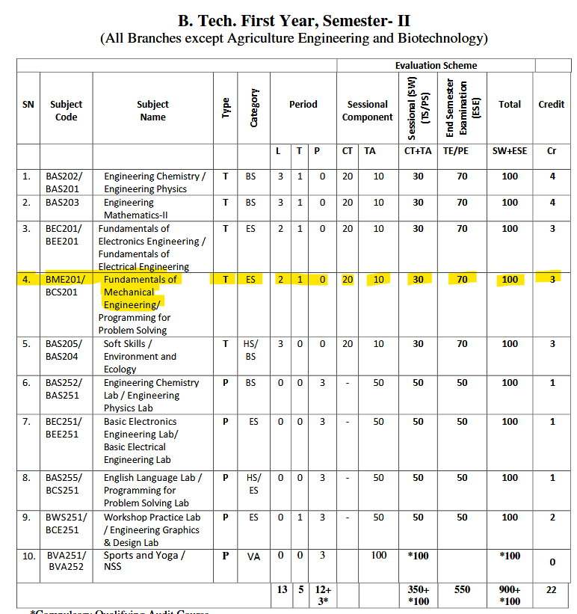
Scheme
Total Marks: 100 (70 University Exam + 30 Internal marks)
Internal marks (30) = 15 marks ST + 15 marks TA
ST: 15 Marks- ST-I, ST II and ST-III
Name of Exam | ST I | ST II | ST III
Max. Marks | 30 | 30 | 40
Syllabus | 1.5 Unit | 1.5 Unit | 2 Units
Eligibility | Attendance min. 75% and in CT | Attendance min. 75% and in CT | Attendance min. 75% and in CT
Criterion | Average of best two
TA: 15 Marks – 5 marks attendance + 5 marks quizzes + 5 marks class tests

Slide 3

More than 10 years research experience
More than 3 years teaching experience
Awarded with National level fellowships from Ministry of Education
Delivered more than 10 expert talks at various paltforms
Published more than 10 Research Papers in various International Journals
Published 3 Indian Patents.

Slide 4
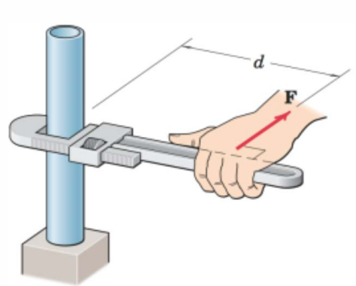
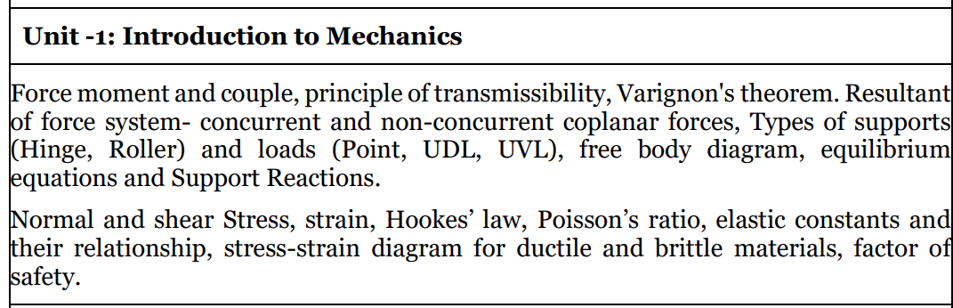
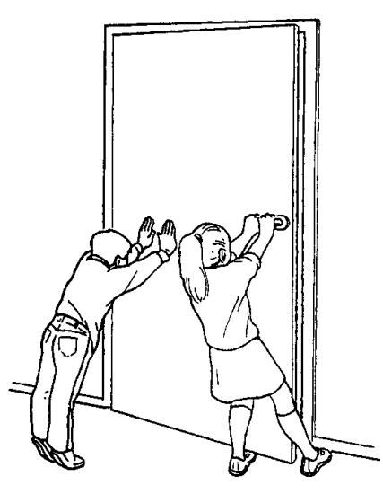
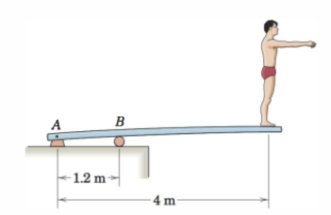
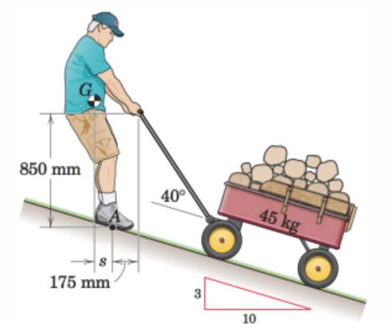
Syllabus: Unit-1

Slide 5
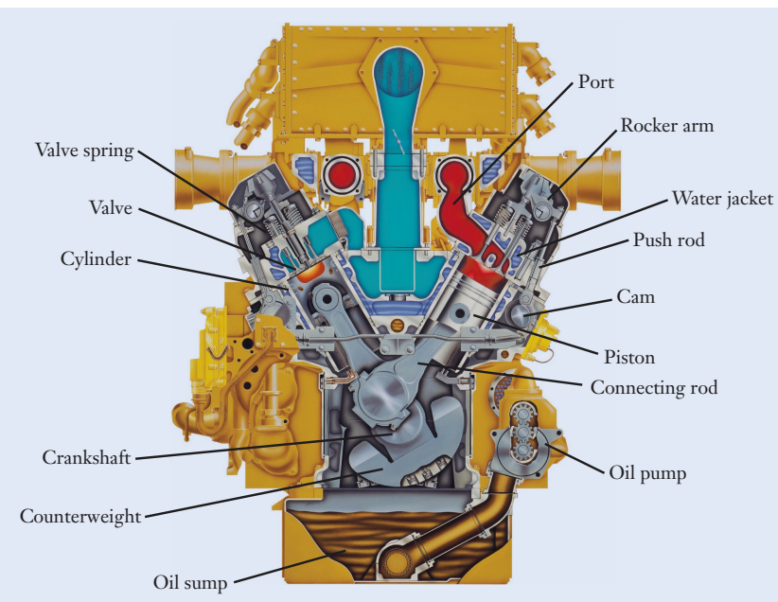
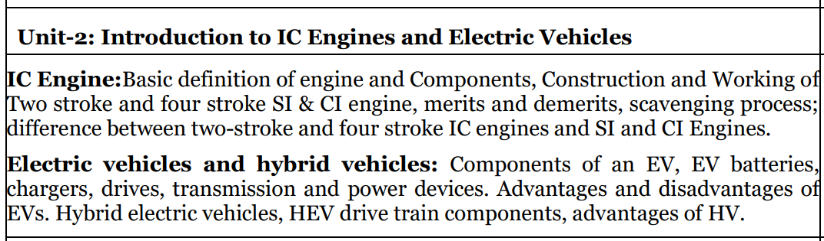
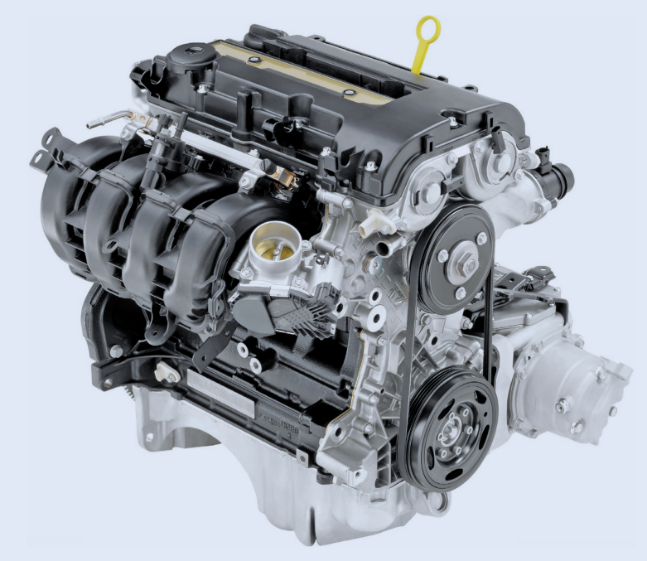

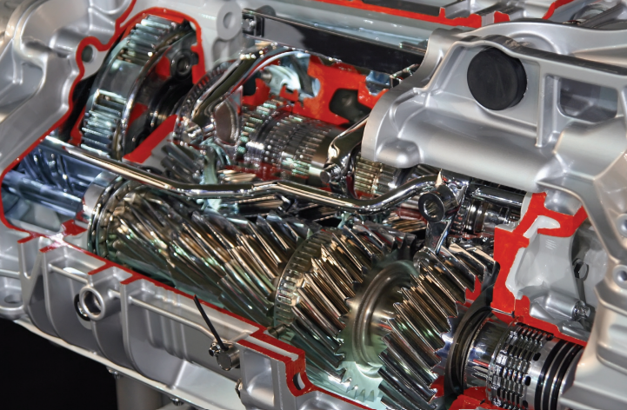
Syllabus: Unit-2

Slide 6
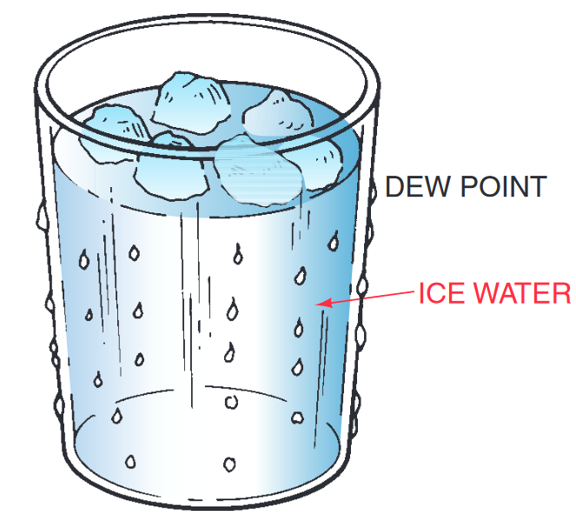
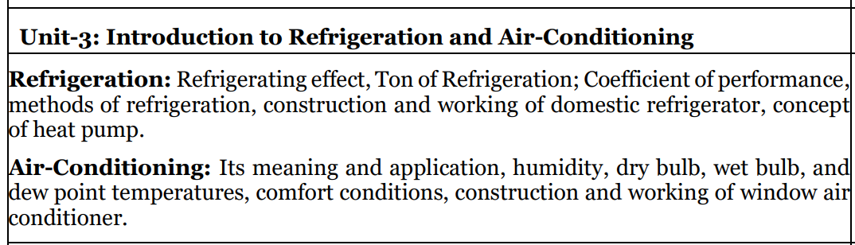
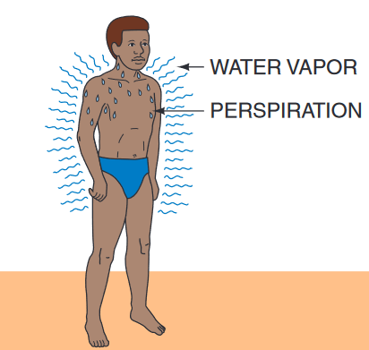
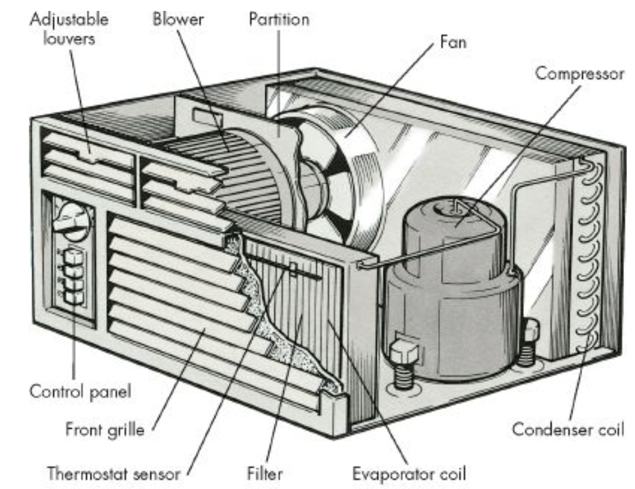
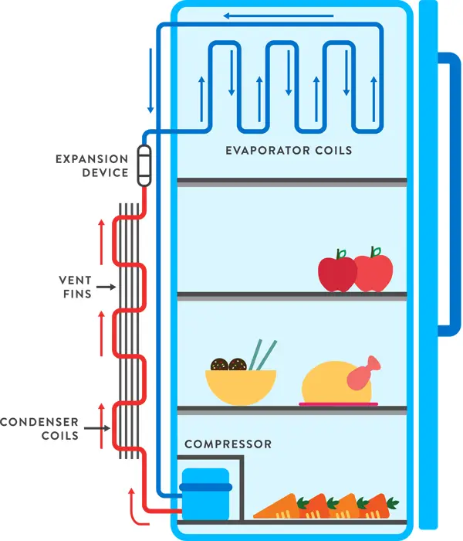
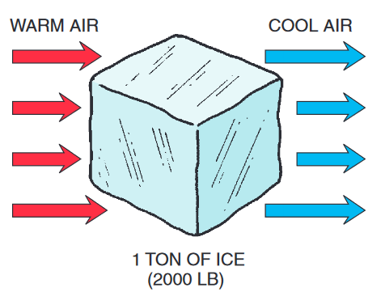
Syllabus: Unit-3

Slide 7

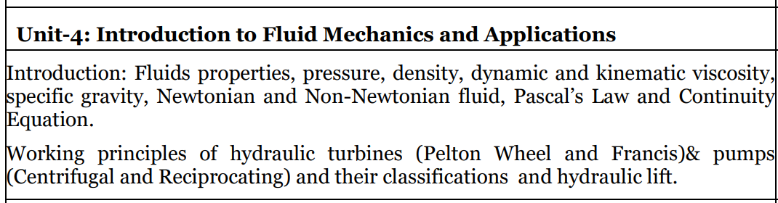
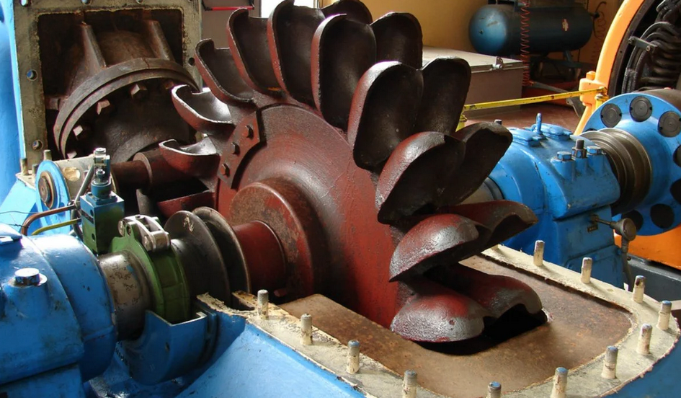
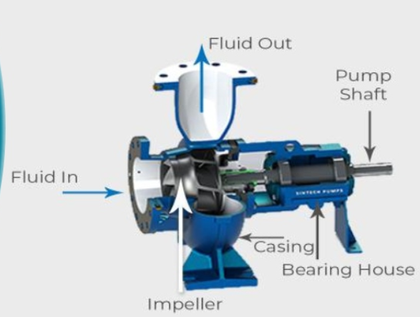
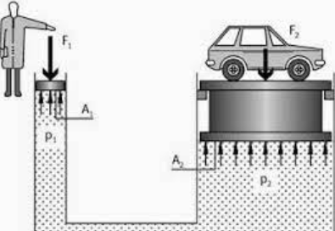
Syllabus: Unit-4
https://youtu.be/JJfppydyGHw

Slide 8

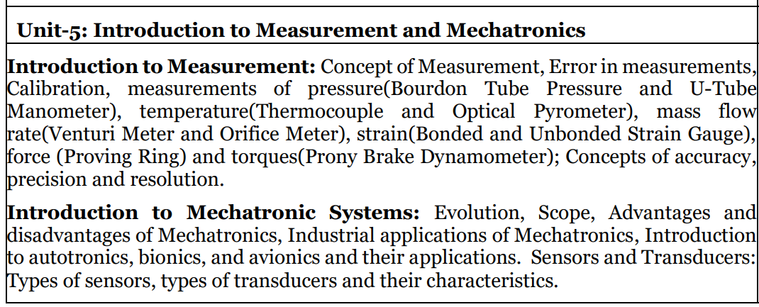
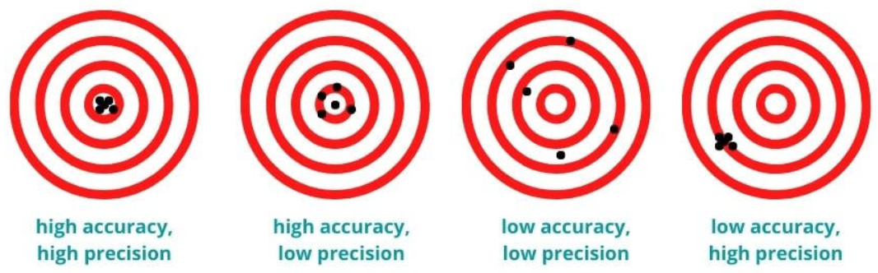
Syllabus: Unit-5

Slide 9

Application of Engineering Mechanics
Physics-based simulation https://youtu.be/8oIQy6fxfCA
Kerbal Space Program https://youtu.be/P_nj6wW6Gsc
Development of physics-based animations for video games or simulations, where the principles of kinematics and dynamics are used to simulate realistic movement and behavior of virtual objects. Understanding how forces, velocities, and accelerations interact in physical systems can help in creating accurate and visually appealing animations.
https://github.com/dilevin/CSC417-physics-based-animation
https://www.toptal.com/game/video-game-physics-part-i-an-introduction-to-rigid-body-dynamics
https://en.wikipedia.org/wiki/Kerbal_Space_Program

Slide 10
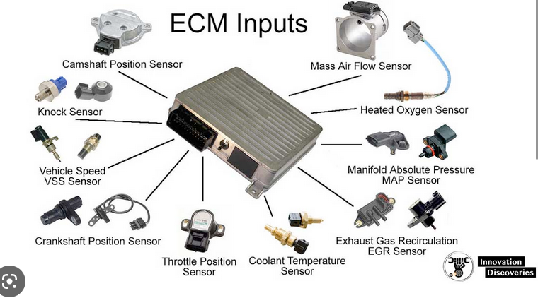
Application of computer science in IC Engine & Hybrid Vehicle
The Engine Control Module (ECM) uses a variety of complex algorithms and programming logic to control the operation of the engine.
https://innovationdiscoveries.space/whats-an-engine-control-module-ecm/amp/

Slide 11

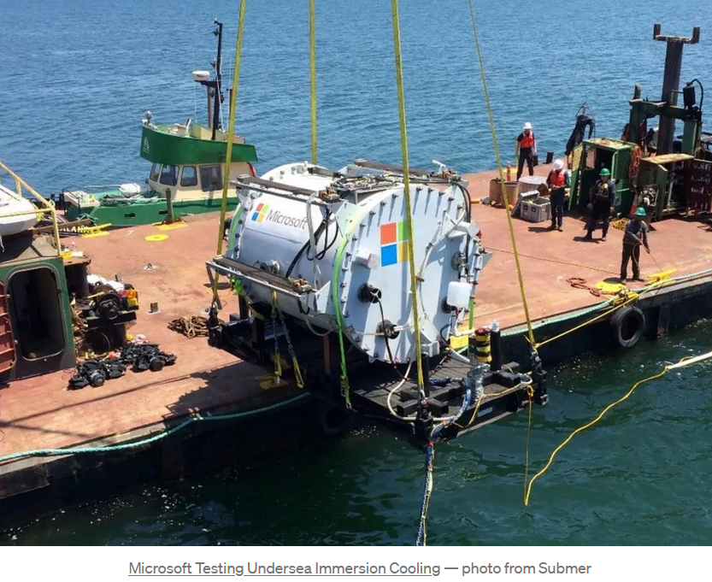
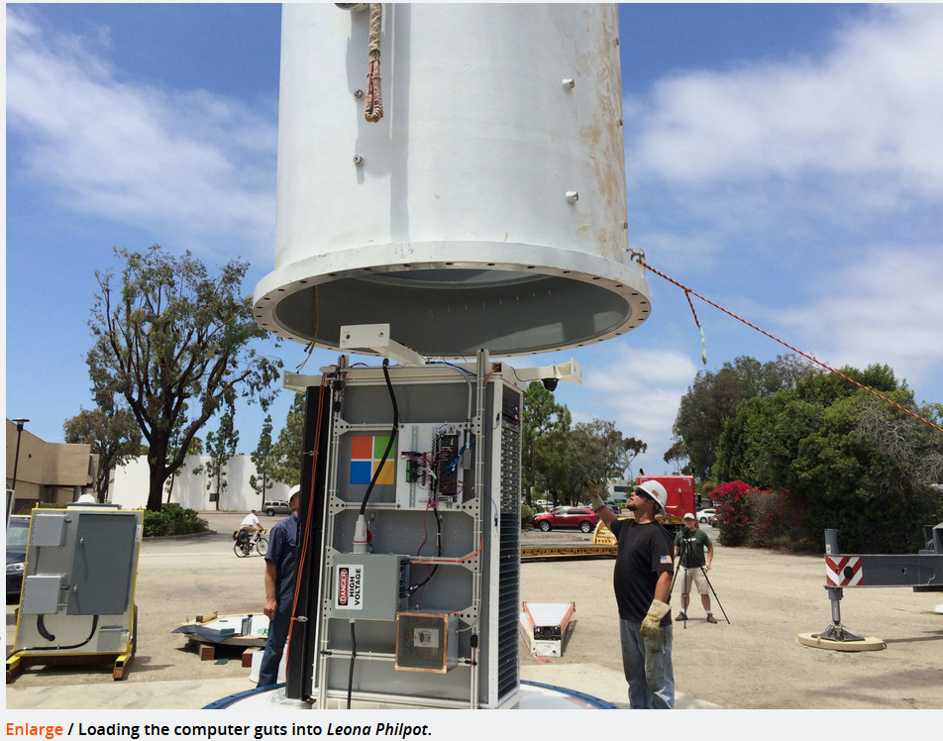
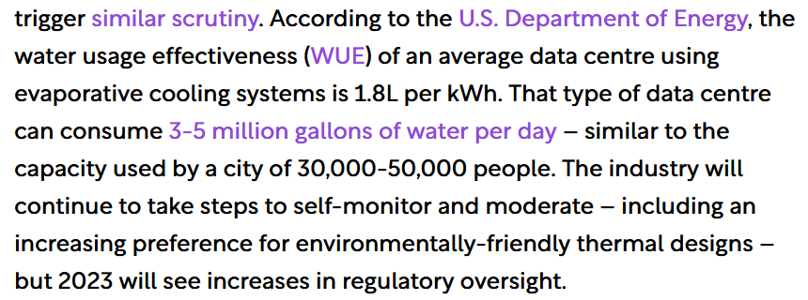
Application of Refrigeration & Air-Conditioning
https://arstechnica.com/information-technology
https://datacentremagazine.com/articles/efficiency-to-loom-large-for-data-centre-industry-in-2023

Slide 12
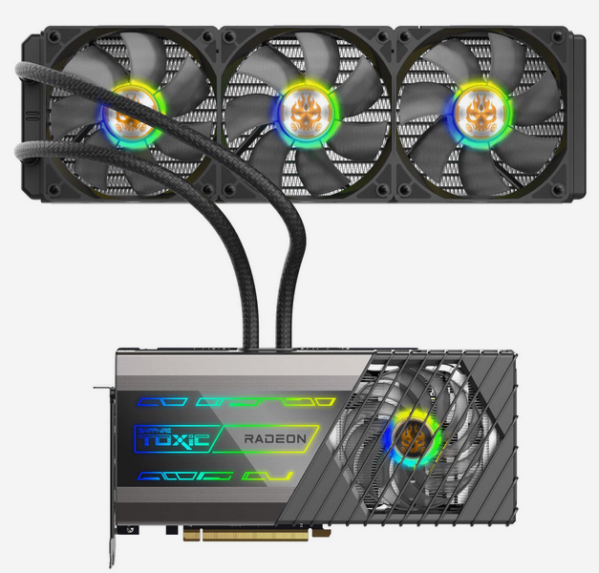
Application of fluid mechanics
Cooling Solutions: Fluid mechanics plays a vital role in designing efficient cooling solutions for computer hardware, such as central processing units (CPUs), graphics processing units (GPUs), and power electronics.
Heat sinks, heat pipes, and liquid cooling systems utilize principles of fluid mechanics to transfer and dissipate heat generated by electronic components.
https://www.asetek.com/liquid-cooling/gaming-enthusiasts/gpu-cooling/

Slide 13
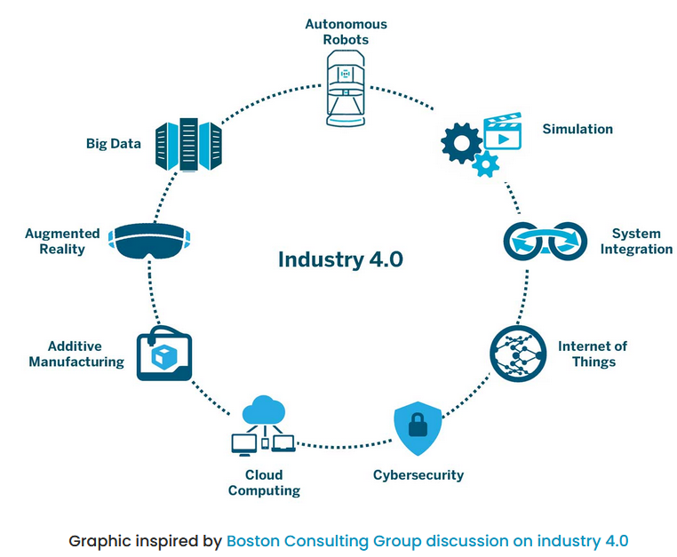
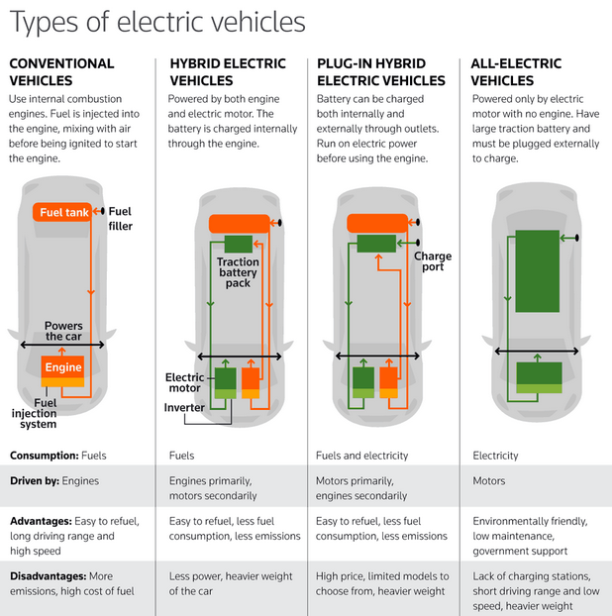

Application of Mechatronics
https://aethon.com/mobile-robots-and-industry4-0/
https://youtu.be/y8bJk_hGYD4
https://youtu.be/2_aYA2Ob-Go

Slide 14
Why this course?
Interdisciplinary Knowledge: This course can provide you a basic understanding of mechanical principles, such as mechanics, IC engine, Electric Vehicle, Fluid Mechanics, RAC and Mechatronics.
This interdisciplinary knowledge can enhance your problem-solving skills and enable you to design software solutions that integrate with mechanical systems, such as robotics, automation, and IoT devices.
This can be valuable in the modern world where interdisciplinary approaches are increasingly becoming important for innovation and technological advancements.

Slide 15
Why this course?
Diversified Skill Set: It can broaden your knowledge beyond computer programming and software development and equip you with a well-rounded skill set that includes knowledge of mechanical principles, and physical design considerations.
This can make you more versatile and adaptable in the job market, as they can potentially work in industries that require expertise in both computer science and mechanical engineering.

Slide 16
Why this course?
Career Opportunities: Many industries, such as automotive, aerospace, robotics, and manufacturing, require professionals who have a solid understanding of both computer science and mechanical engineering.
By having an introduction to this course, computer science students can gain a competitive edge in the job market, as you would be better positioned to pursue careers in these industries.
This can open up diverse career opportunities and increase their employability prospects.

Slide 17

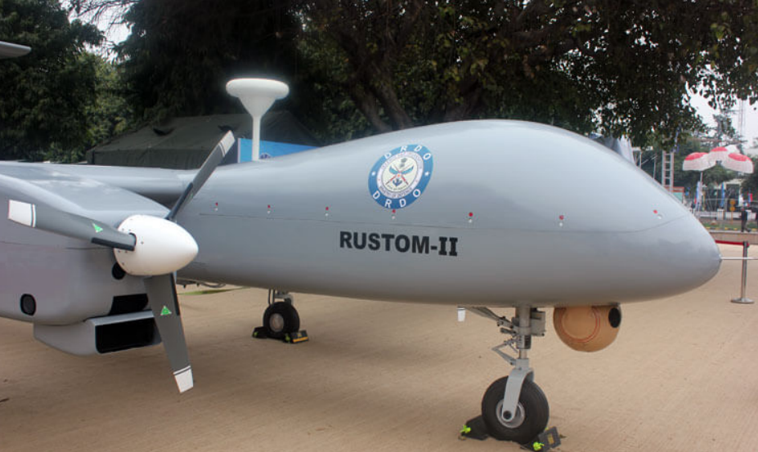
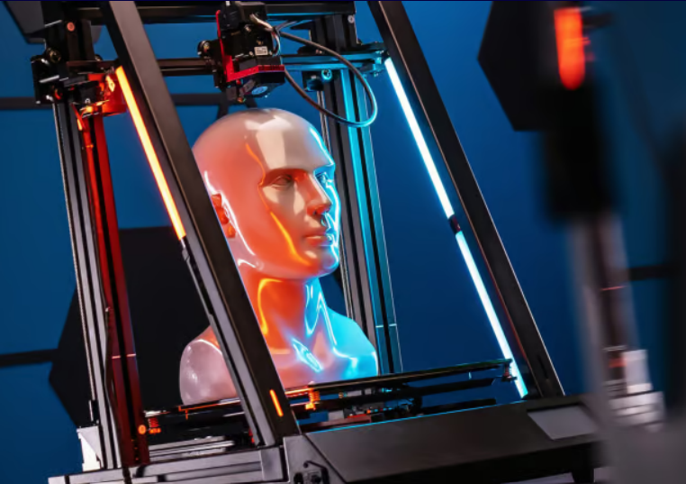
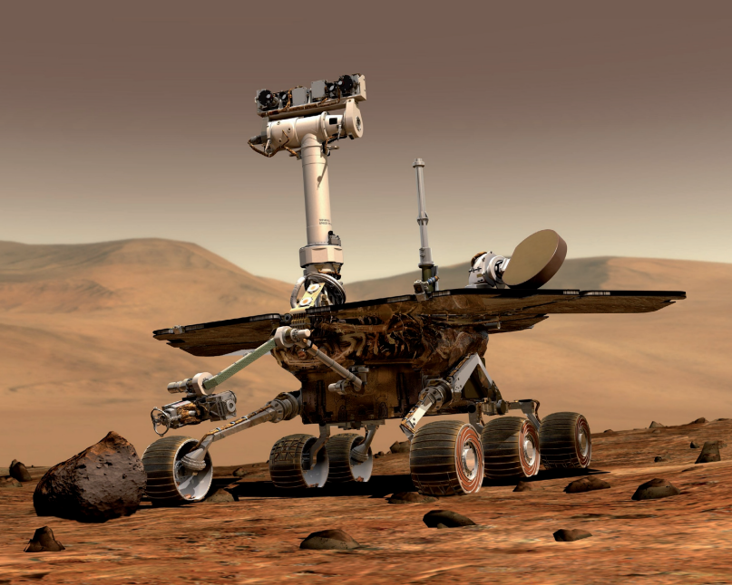
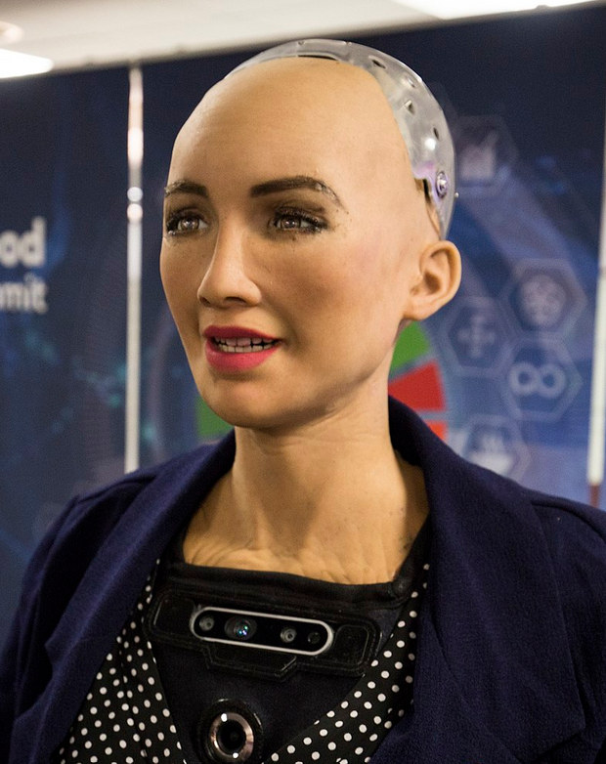
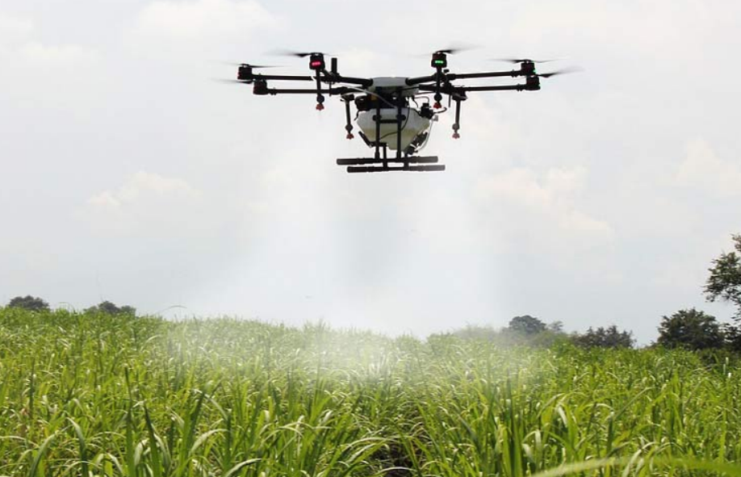
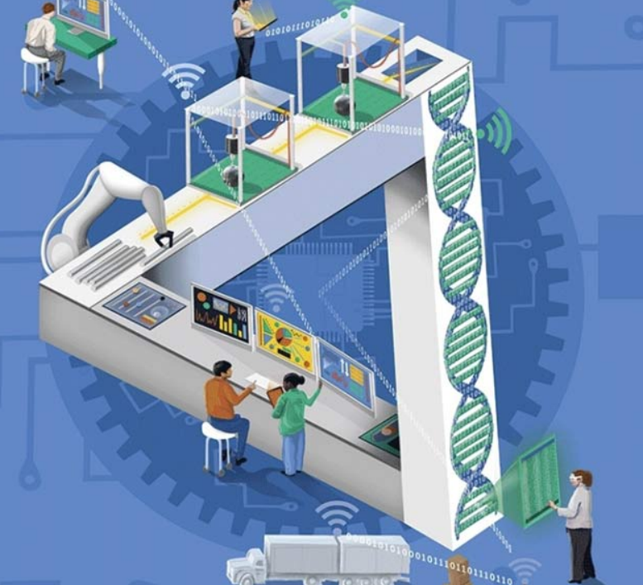
Integration: MEChatronics

Slide 18
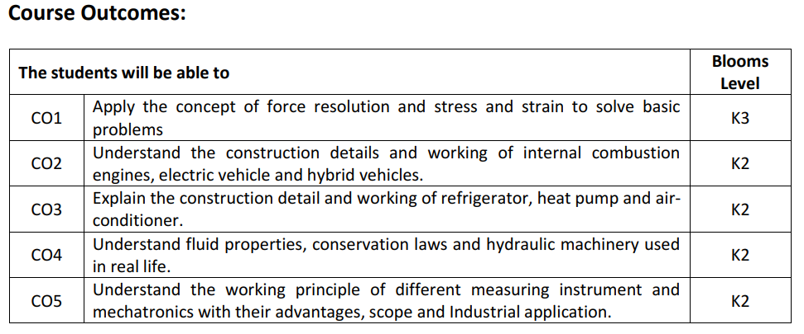
Course Outcomes
https://youtu.be/7Wm6vy7yBNA

Slide 19
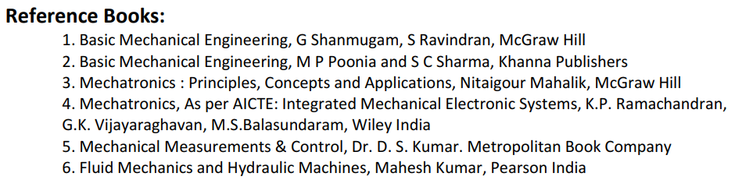
Books:

Slide 20

Thank you

